Slide 1
Jaypee University of Engineering & Technology, Guna
Using GAN for Fashion
Project No. 53
By
Sneh Singh (191B262)
Vanama Yaswanth (191B278)
Vidhi Mathur(191B282)
Under the Supervision of
Dr. Ajay Kumar
Department of Computer Science & Engineering
Notes:
Do :
Font size in all slides: Heading :32 ,Times New Roman
Text: Times New Roman,14
One line space in between two points,

Slide 2
CONTENTS
Sr no. | Title | Page No.
1 | Introduction | 3
2 | Objective | 5
3 | Design | 6
4 | Methodology | 9
5 | References | 13

Slide 3
Introduction
GANs?
Generative Adversarial Networks.
An approach to generative modeling using deep learning methods.
Unsupervised learning task in machine learning.
Discovers and learns the regularities or patterns in input data in such a way that the model can be used to generate or output new examples.

Slide 4
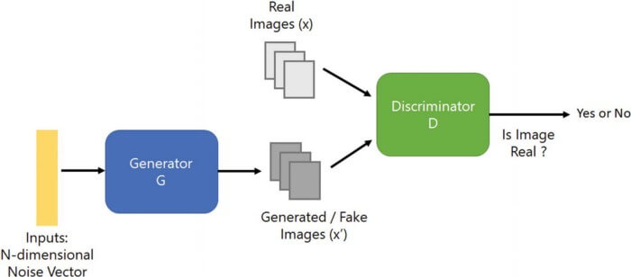
Figure 1: General GAN model

Slide 5
Objective
Our aim is to create a Deep Learning System that will be able to generate good-looking and creative high-fashion clothing.
We will develop a custom deep learning framework that has the ability to generate high fashion clothing items.
It will predict the next trendy items in the fashion industry.

Slide 6
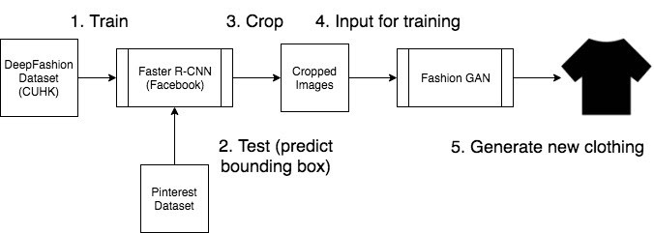
Design
Figure 2: Deep Learning Model Framework

Slide 7
Image Preprocessing
Conversion of image to numpy array
Flattening the array: Flattening an array is a process of reducing the dimensionality of an array
Dropping the label from image
Scaling :
Used to reduce the size of a digital image.
The smaller image will have fewer pixels than the source image, so most algorithms will provide fairly good results

Slide 8
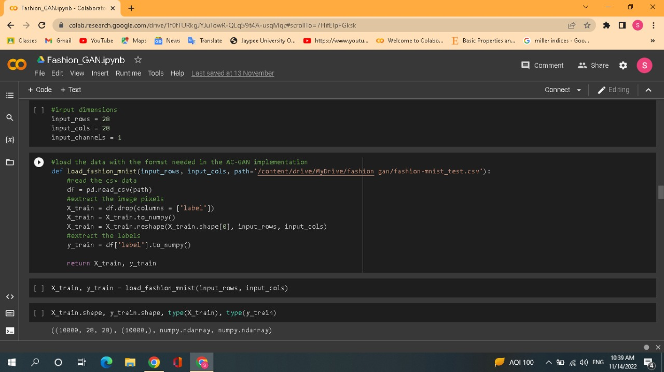
Image 1: Preprocessing

Slide 9
Methodology
GAN consists of two sub-models:
the generator model that we train to generate new examples
the discriminator model that tries to classify examples as either real (from the domain) or fake (generated)
Dataset used : DeepFashion Dataset containing around 800k diverse fashion images with various backgrounds, angles, lighting conditions, etc.

Slide 10
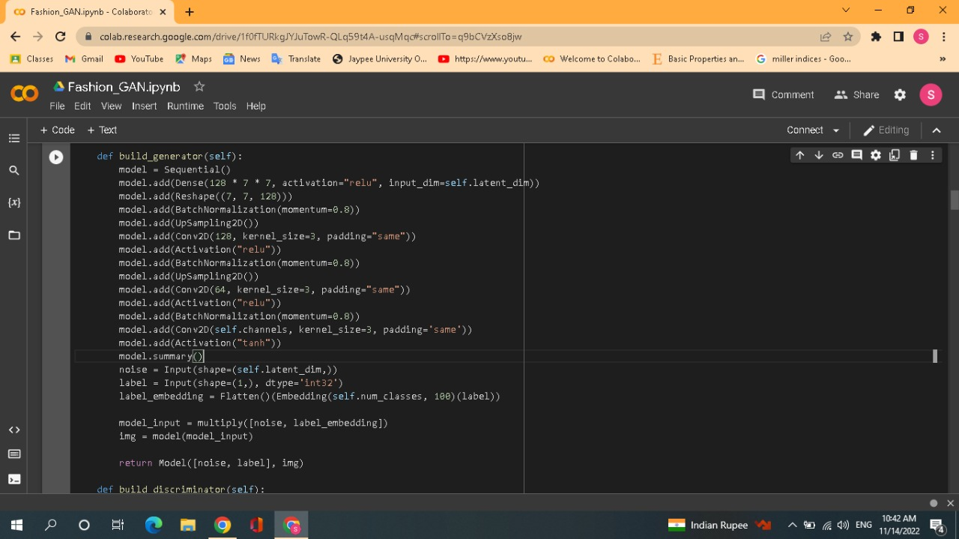
Image 2: Generator Model

Slide 11
Methodology Continued…
In a GAN :
The generator works hard to create images that look real
The discriminator tries to distinguish real images from fake images.
Over time during training, the generator becomes better at generating real images while the discriminator becomes better at figuring what’s real and what’s fake.
The final equilibrium is reached when discriminator can no longer figure out whether the images produced by the generator is real or fake.

Slide 12
Methodology Continued…
The first part of StyleGAN contains Faster R-CNN which is a real-time object detection model.
We will train our Faster R-CNN with the DeepFashion Database .
After training the Faster R-CNN against the DeepFashion database, the network will be able to predict where the clothing piece is, given any test image.
We then finally pass the cropped image to our Fashion GAN, which will be implemented using DCGAN or Deep-Convolutional Generative Adversarial Network.

Slide 13
References
https://towardsdatascience.com/deepstyle-f8557ab9e7b
https://towardsdatascience.com/deepstyle-part-2-4ca2ae822ba0
https://machinelearningmastery.com/what-are-generative-adversarial-networks-gans/

Slide 14
THANK YOU!

